Slide 1
FSI Bot Attach Play Partner/Customer Skill up Initiative
Tech Team:
Annie Xu
Anthony Franklin
Ariel Luna
Claire Rehfuss
Praveen Rawat
Sowmyan Soman Chullikkattil
Wayne Smith

Slide 2
Agenda
Why we build this program
Architectural Diagram
Demo
Skilling Strategy
Timeline
Open discussion

Slide 3
Why we want to build this program
Low hanging fruit, short build-with engagement cycle
Easy to pitch – Very tangible, quick deploy, and low cost
Current lacking good demo and skill assets for FSI Bot solution which leverages best practices and latest tech
Easy integration with different services/product together
Notes:
Manika
Low hanging fruit, short sales cycle & build-with engagement – Great for ACA last mile & building capacity quickly!
Easy to pitch – Very tangible, quick deploy, and low cost - Deployable in as little as 3 weeks
Penetrate new customers & use as conversation starter - Chatbots are exciting and compelling for a wide range of customers

Slide 4
The FSI Bot

Slide 5
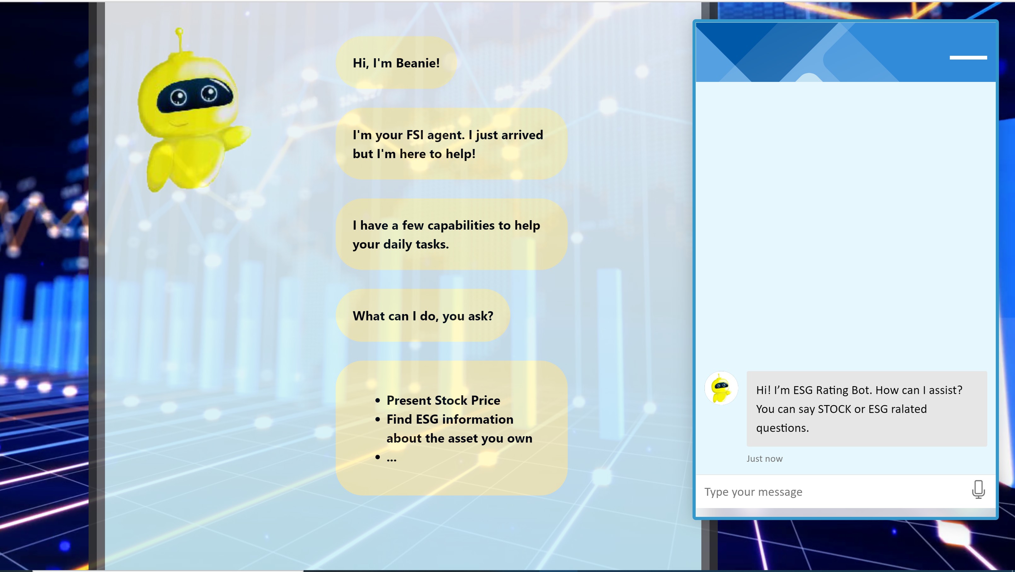
Product Demo
https://usocpfsibot.azurewebsites.net
Notes:
Front End
Stock
QNA for ESG – Word Doc

Slide 6
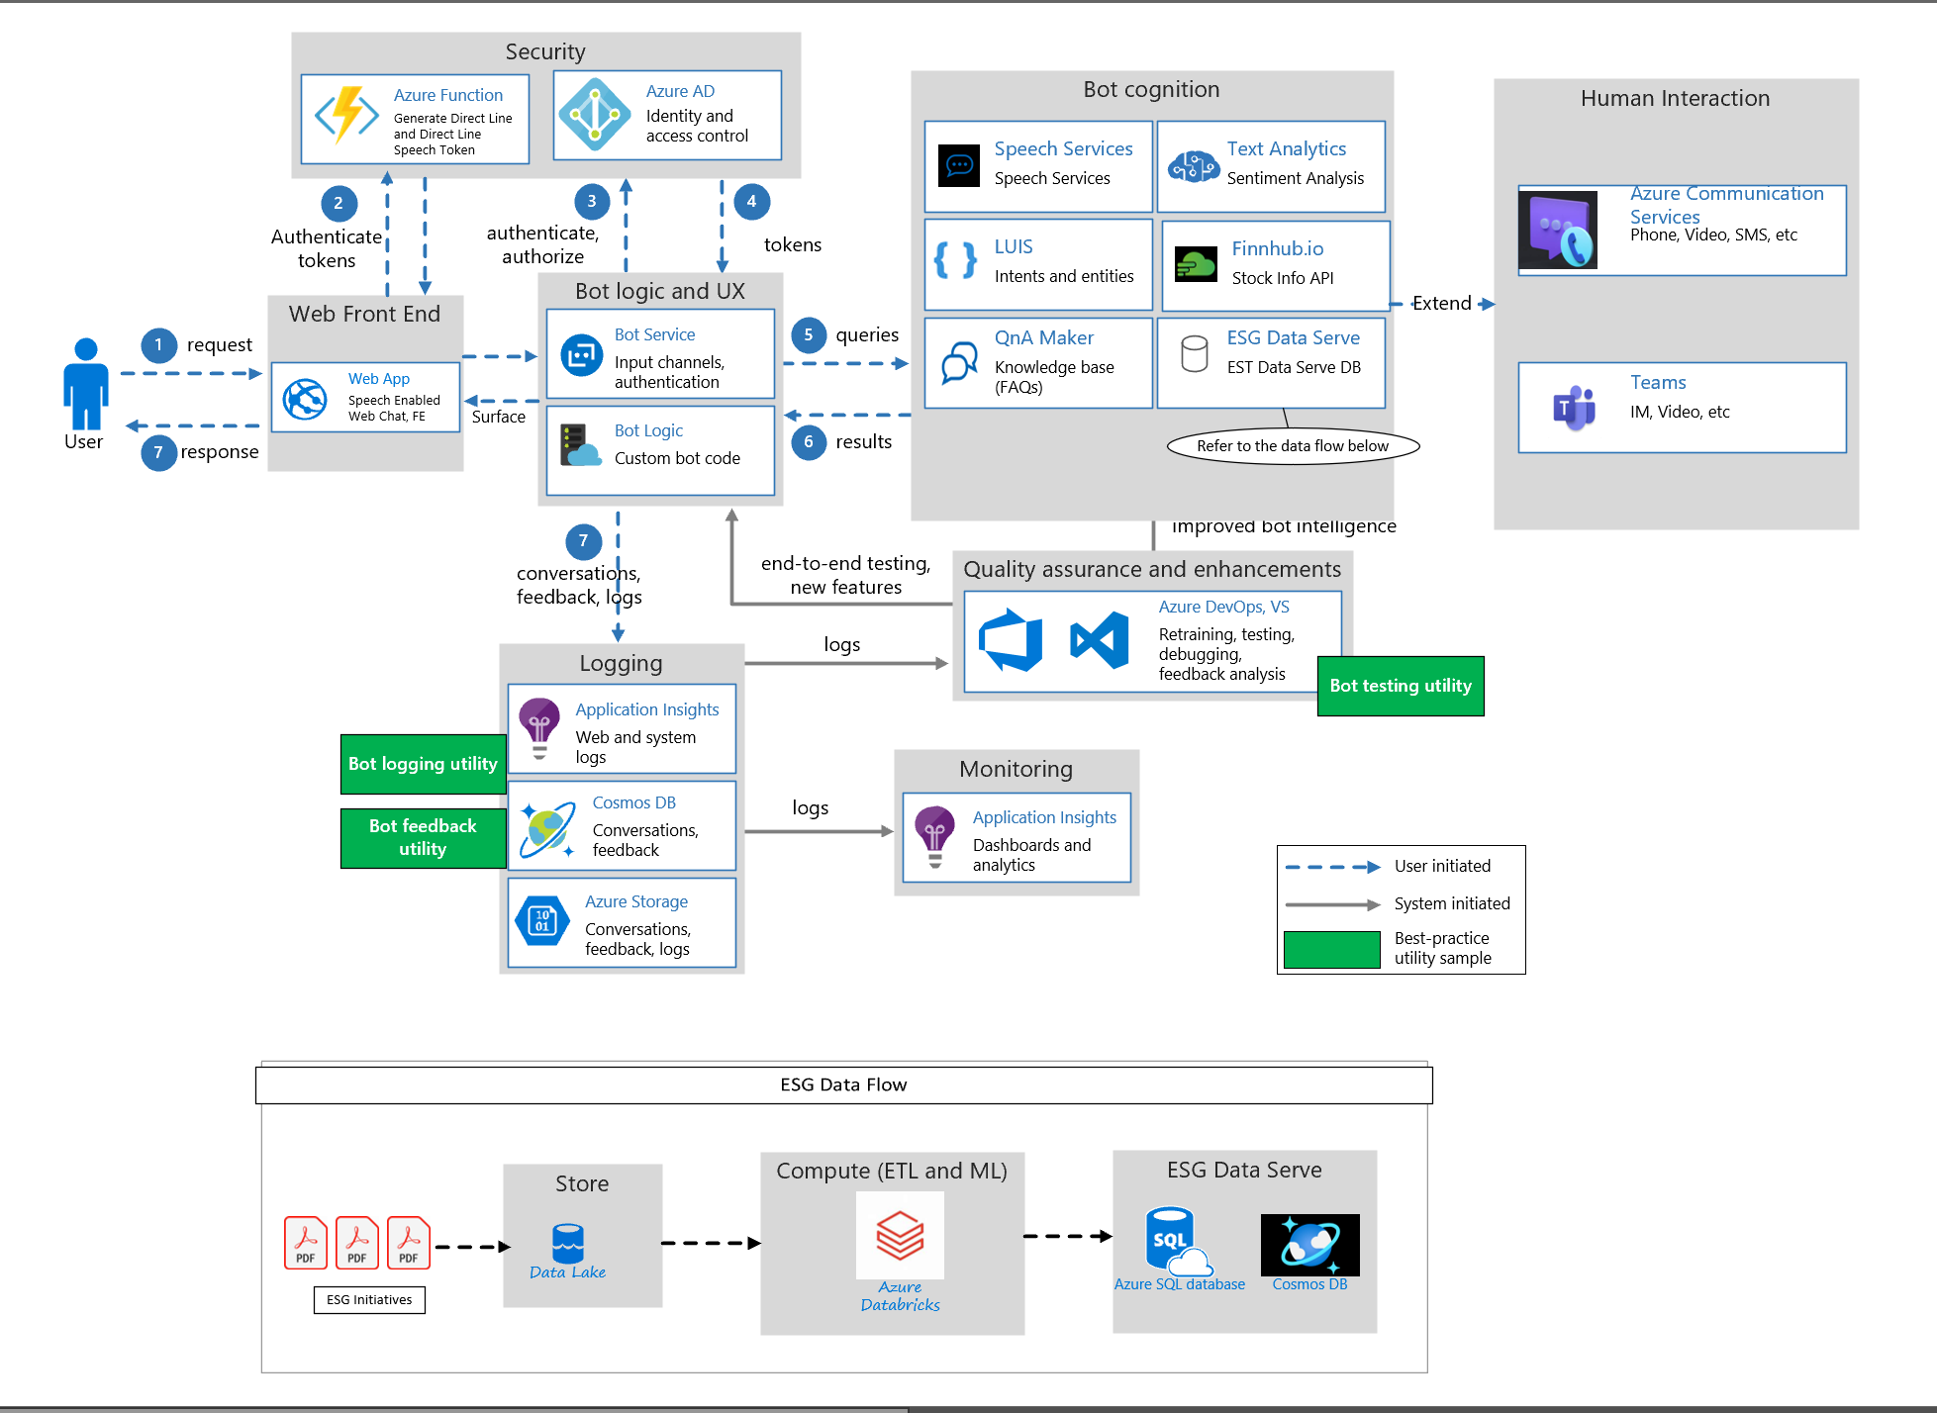
Application Architecture

Slide 7
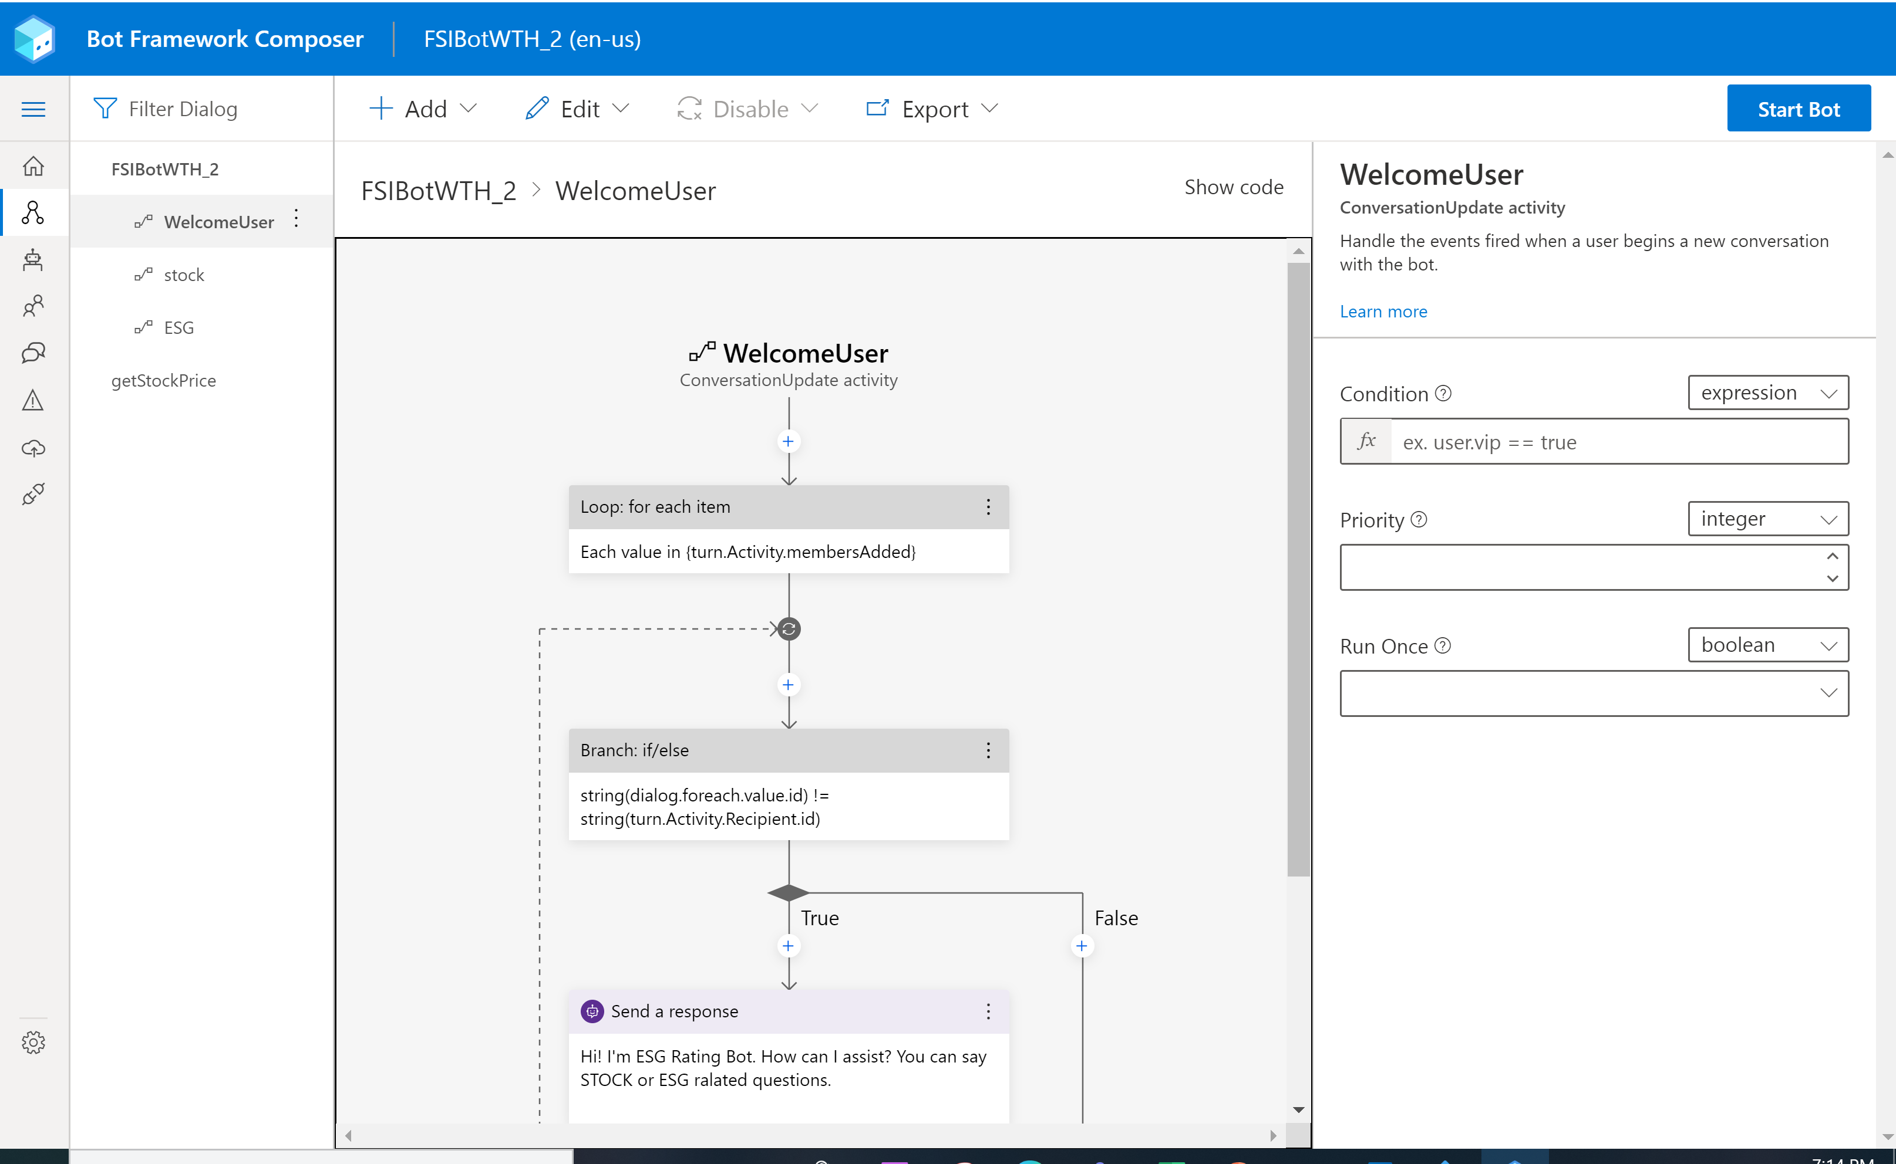
Cost: Bot application with Bot Framework Composer
Bot Framework Composer
=
= USD 0
{Code }
Notes:
Azure Bot Service and Bot Framework provide tools to build, test, deploy, and manage intelligent bots, all in one place. Through the use of modular and extensible framework provided by the SDK, tools, templates, and AI services developers can create bots that use speech, understand natural language, handle questions and answers, and more.
Azure Bot Service - S1 tier, 100000 messages in Premium Channel (West US) = $50 USD monthly
Azure Bot Service offers both the Web App Bot which automatically deploys a Bot on Azure on your behalf, and the Bot Channels Registration offering that enables you to host your bot wherever you like.

Slide 8
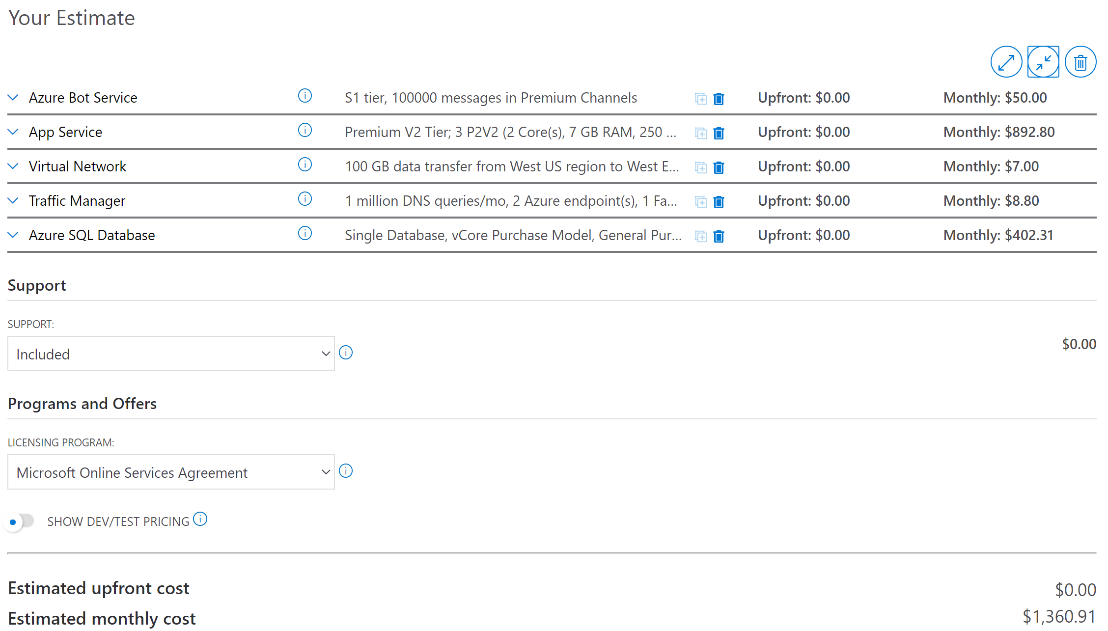
Cost + Platform & Infrastructure Services
USD 1360.91
Notes:
We haven’t added any Support –
Developer – $29 | Developer support is for companies or individuals using Azure in a non-production environment or for trial and evaluation.
Standard – $100 | Standard support is for small- or mid-size companies with minimal business-critical dependence on Azure
Professional Direct – $1000 | Professional Direct support is for mid-size to large companies with substantial business-critical use of Azure.

Slide 9
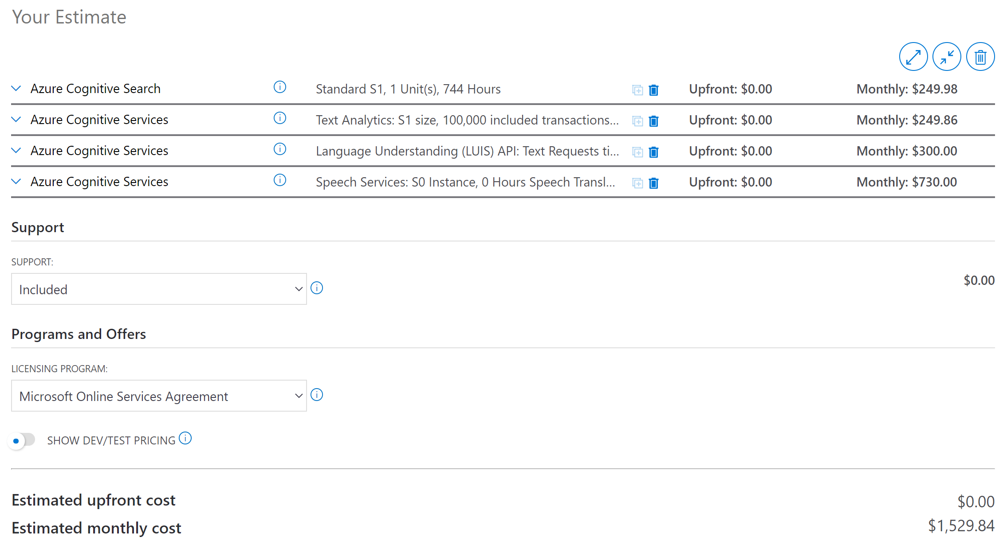
+ Cognitive Services
= USD 2890.75 per month
USD 1360.91+
Notes:
We haven’t even included -
Azure Machine Learning capabilities
Stream Analytics
Data Lake
Event Grid
App Insights
Nor have we included the pricing for Office 365

Slide 10
+ Other Services
Teams
Azure Communication Services
Databricks
Cosmos DB
…
USD 2890.75 +
USD something large

Slide 11
Build Effort
Base Bot - 80% No Code Experience (QNA Maker, Bot Composer, Teams App Studio)
Code/Developer effort needed on: Bot Front End, Services Integration, DevOps Pipeline, Big Data Services integration

Slide 12
A FSI Bot Rebuild Journey
5 minutes to build the QNA
2 hour to build the Bot Conversational Flow – Bot Composer
30 minutes publish to Azure
1 hour integrate with Teams
1 hour to set up DevOps Pipeline
1 hour integrate with Azure Communication Services (in building)
5 hours extension to data services (databricks, cosmos db, azure data lake) for advanced ML work (in building)
– Just a 2 days effort

Slide 13
Partner/Customer Skill Enablement Plan
Briefing Tech Talk
Partner WTH
Partner Train the Trainer Tech Talk
Partner Deliver to End Customer

Slide 14
Roadmap
Dec. 2020
Add Azure Communication Services Integration
WTH Draft Finish
Jan. 2021
Briefing Tech Talk Internally
Data Services Integration
PG review WTH
Feb. 2021
Internal WTH Run Through
Partner Facing Briefing Tech Talk
Mar. 2021
Partner Facing WTH
Partner Facing WTH Train the Trainer session

Slide 15

Call to Action
Demo End Point: https://usocpfsibot.azurewebsites.net
WTH Asset Entry:
https://github.com/Microsoft-US-OCP-Conversational-AI/Conversational-AI-Attach-Play
Tech Team Contact: Direct IM/Email to any of us

Slide 16
Open Discussion
Feedback
Share
Contribute

